Slide 1

MILLMAX™
CONFIDENTIAL
for internal use only
For Vendors

Slide 2
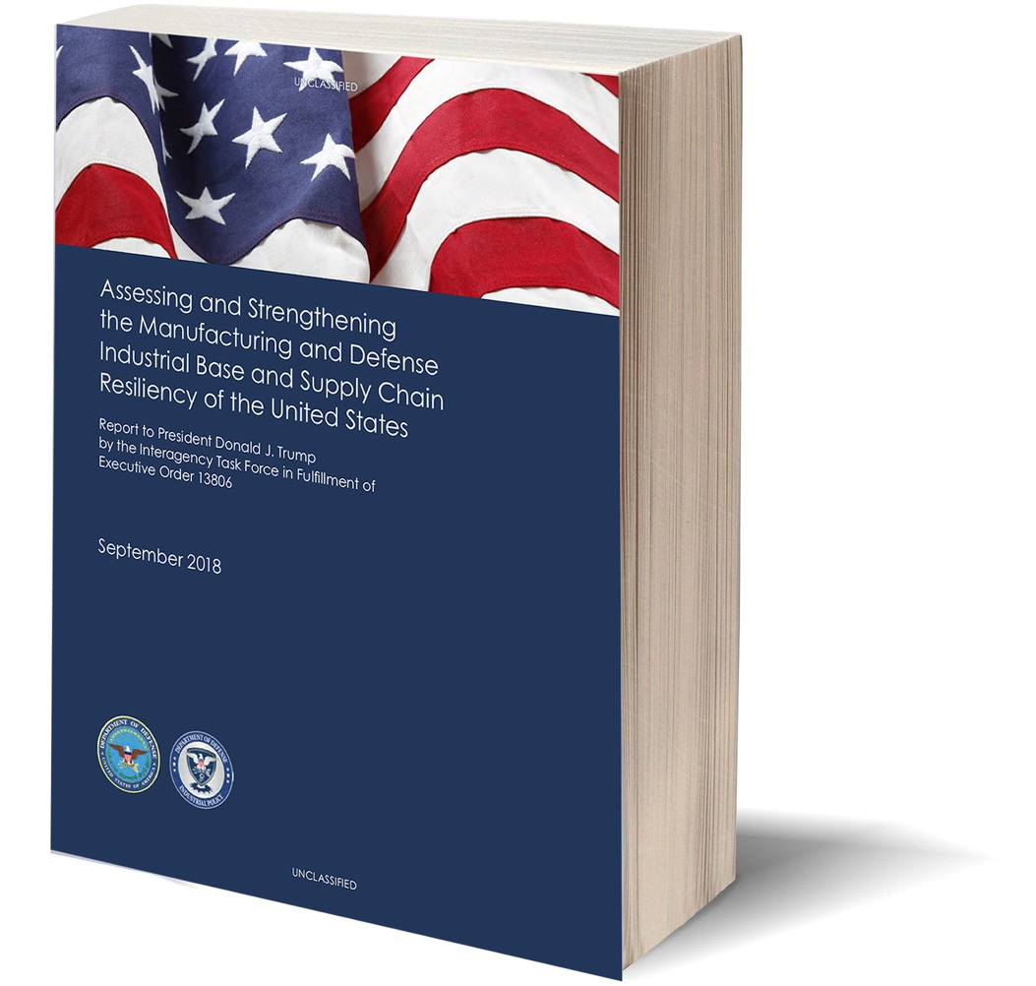
This 2018 Department of Defense Assessment found that America’s Supply Base is not ready for the
“FIGHT
TONIGHT”
Notes:
This 2018 Department of Defense Assessment found that America’s Supply Base is not ready for the “Fight Tonight”. This has been proven to be correct with the supply issues exposed by the coronavirus.

Slide 3
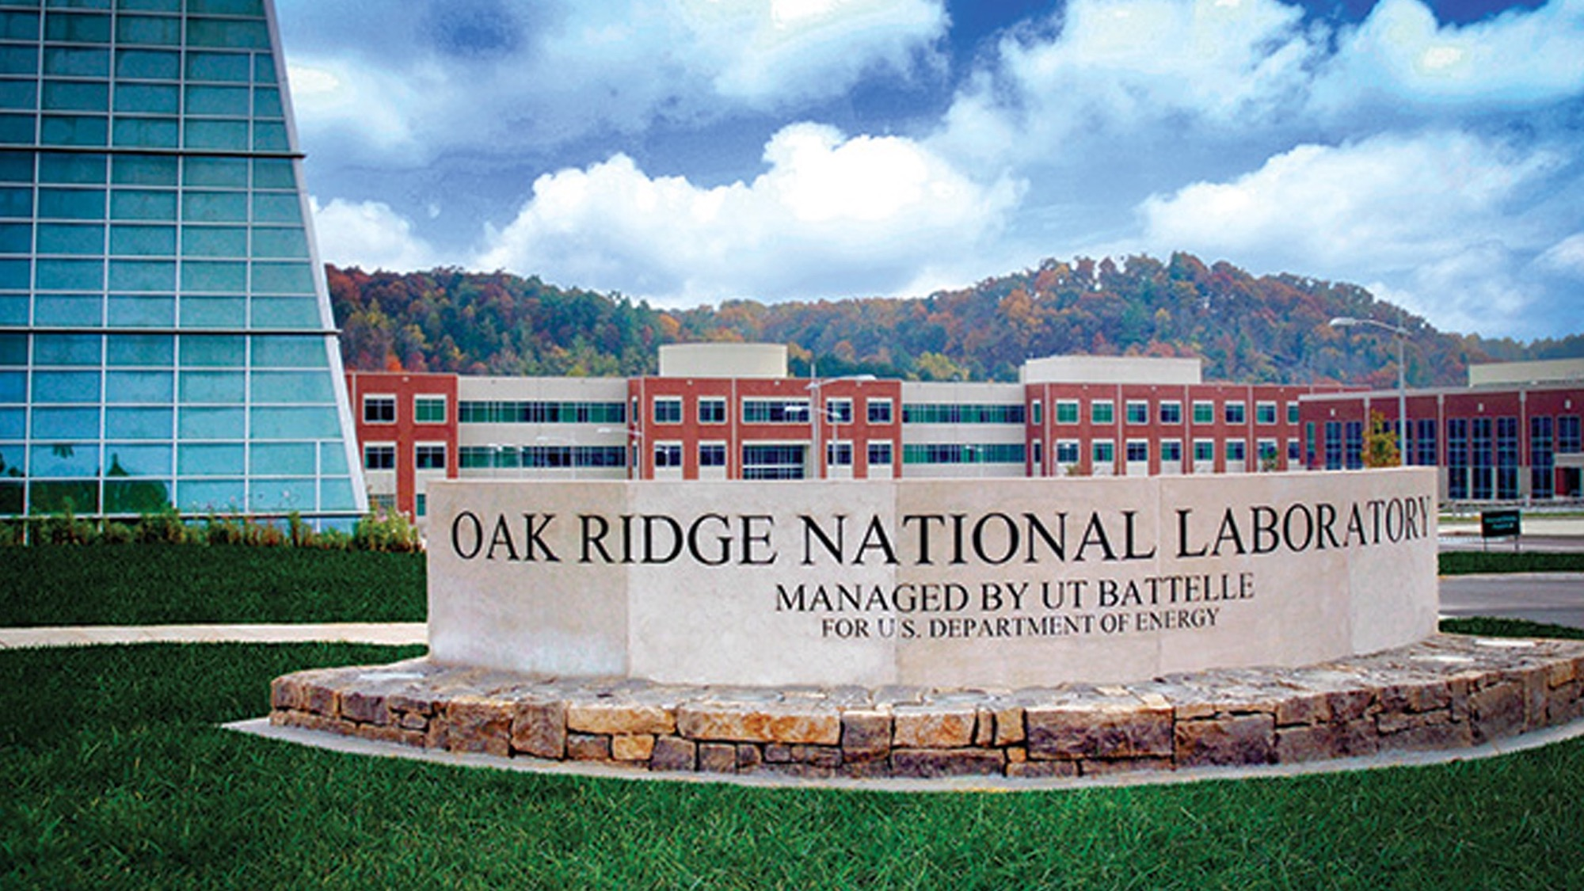
In response they established a new Machining Research Center
Notes:
In response to this assessment, they established a new Machining Research Center at the Oak Ridge National Laboratory in Tennessee.

Slide 4
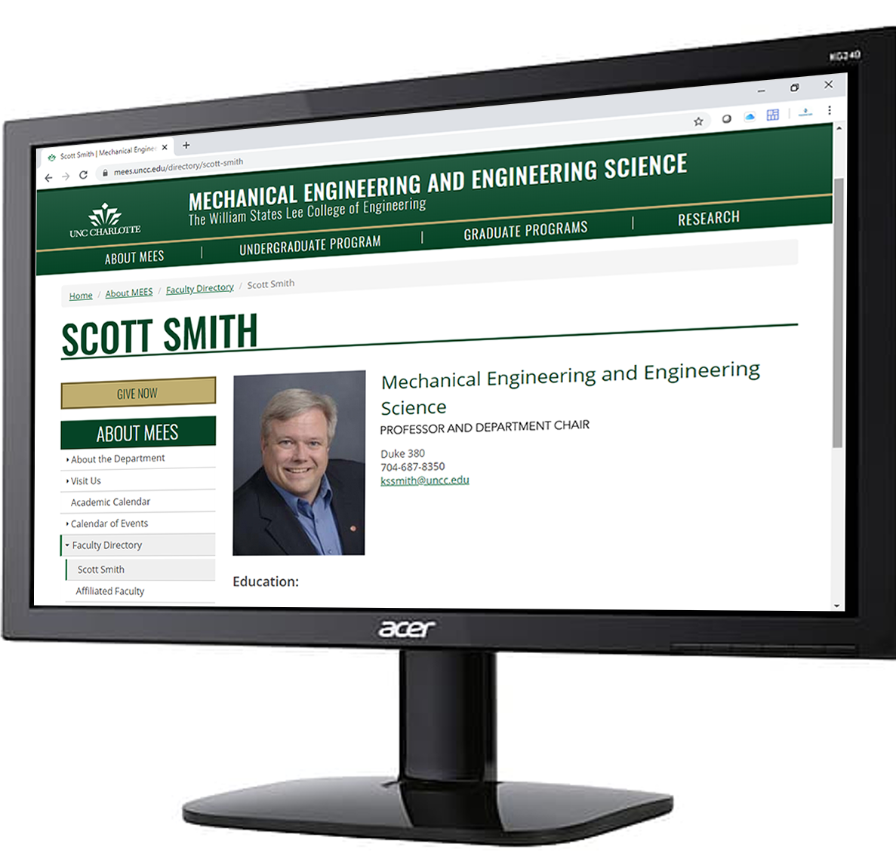
Then they recruited the World’s most renowned experts.
Notes:
The they recruited the world’s most renowned machining experts, like Dr. Scott Smith the former head of the College Engineering at the University of North Carolina at Charlotte. Dr. Smith is also credited as being one of the originators of high-speed machining.

Slide 5
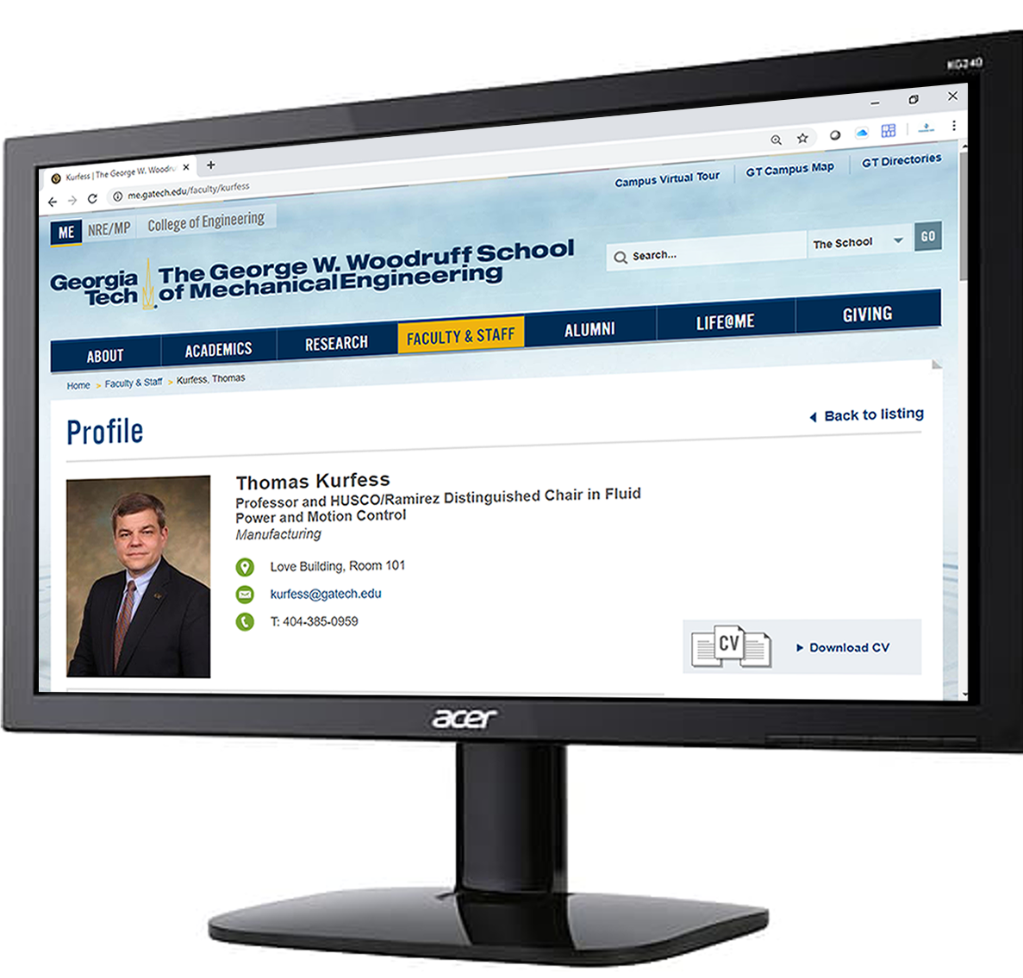
Then they recruited the World’s most renowned experts.
Notes:
Oak Ridge’s Chief Manufacturing Officer Dr. Tom Kurfess came from Georgia Tech. Prior to that he served in the White House Office of Science and Technology Policy.

Slide 6
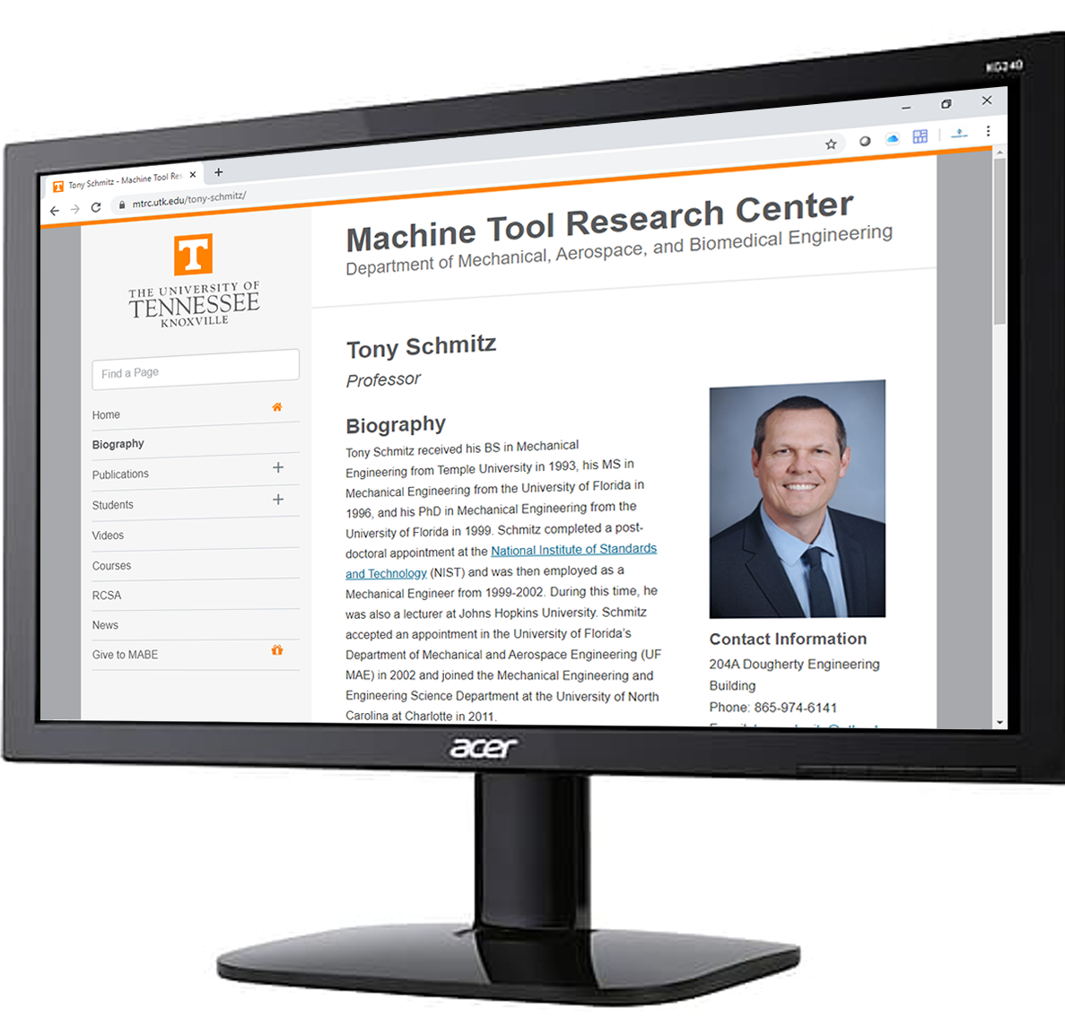
Then they recruited the World’s most renowned experts.
Notes:
Dr. Tony Schmitz is a world renown researcher, speaker and author. He is serving a joint appointment to the University of Tennessee and Oak Ridge National Laboratory.

Slide 7


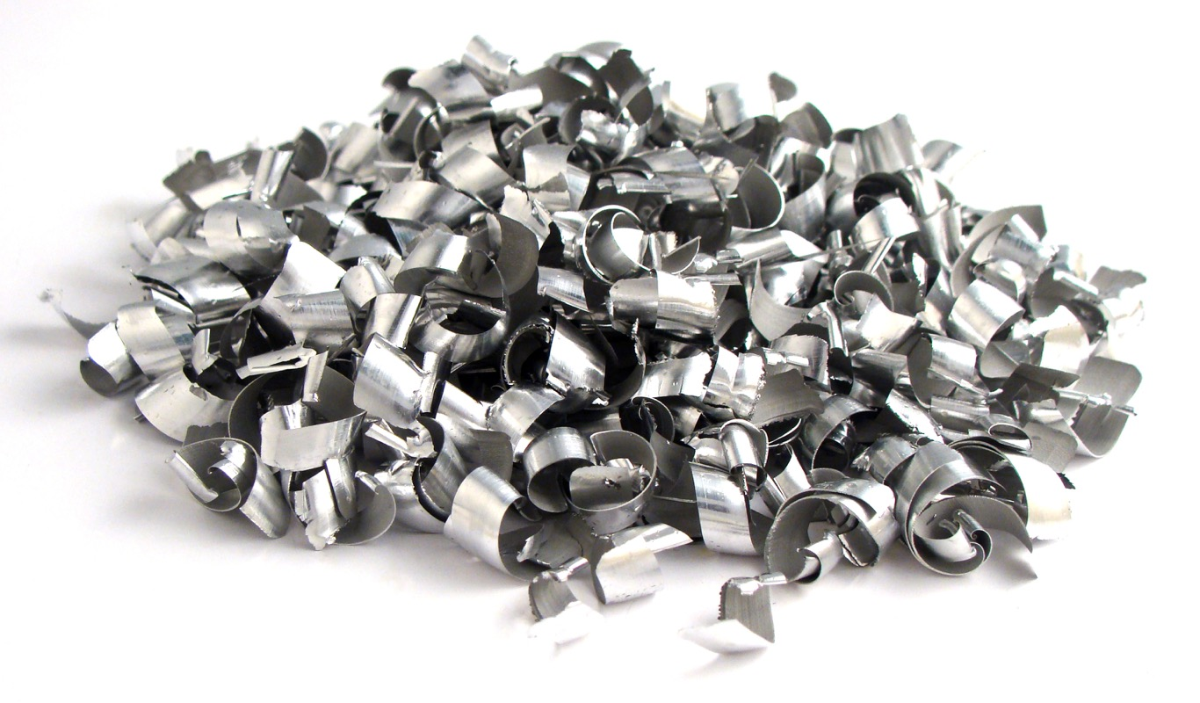
Notes:
When they decided on their first project for the new machining research group, they needed to use technology that was both proven and ready to deploy, but also one that would make the maximum amount of impact in the shortest amount of time.

Slide 8
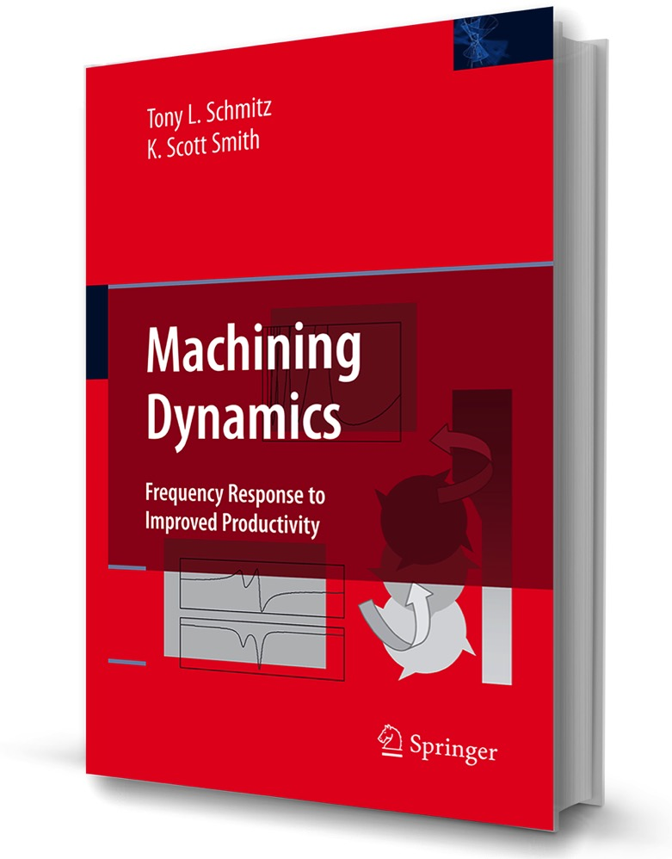
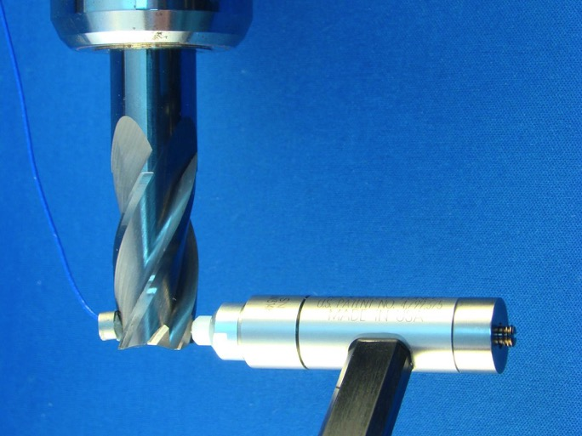
Notes:
They chose the science of machining dynamics, also known as the impact or tap-testing of milling tools.

Slide 9
Project Title:
Improving Milling Performance on New
CNC Machining Centers
with Machining Dynamics
Notes:
To deploy this project nationwide they chose MSC. The project is named: Improving Milling Performance on New CNC Machining Centers with Machining Dynamics

Slide 10

“For this project, MSC is the ideal partner. They have the technical capacity to learn to make the required measurements. They interact directly with almost all of the tens of thousands of machine shops that can benefit from the technology. They sell tools and holders from all major manufacturers and are regarded as an honest broker whose goal is to improve productivity of the machine tool users (their company motto is “Built To Make You Better™”). Their offices are naturally and neatly aligned with US machine tool distributor locations, so the ability to rapidly improve the performance of newly delivered machines is high.”
Oak Ridge National Laboratory
Notes:
Here were their reasons for choosing MSC. “For this project, MSC is the ideal partner. They have the technical capacity to learn to make the required measurements. They interact directly with almost all of the tens of thousands of machine shops that can benefit from the technology. They sell tools and holders from all major manufacturers and are regarded as an honest broker whose goal is to improve productivity of the machine tool users (their company motto is “Built To Make You Better™”). Their offices are naturally and neatly aligned with US machine tool distributor locations, so the ability to rapidly improve the performance of newly delivered machines is high.”

Slide 11


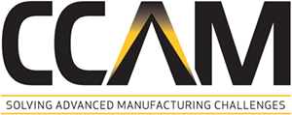
There are a number of machining research centers in the U.S.
Notes:
There are a number of existing machining research centers in the United States.

Slide 12
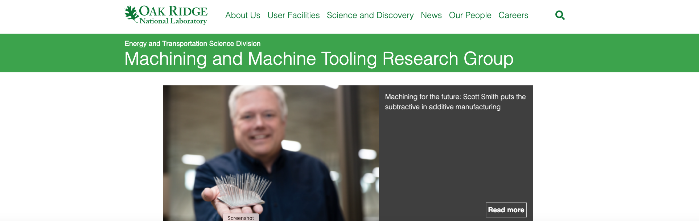
There are a number of machining research centers in the U.S.
Only one is at one of America’s 17 National Laboratories where solutions to the world’s biggest problems are discovered.
Notes:
But only one was established at one of America’s 17 National Laboratories, fully funded by an executive order by the President of the United States and the Department of Energy.

Slide 13
Access is limited to members who pay large sponsorship fees
Notes:
These other existing centers limit access to members that must pay very large annual sponsorship fees.

Slide 14



Oak Ridge chose MSC to have access to the best tooling regardless of brand or membership status
Notes:
Because they do not require sponsorships for their funding, Oak Ridge chose MSC to access the best in class tooling no matter who they come from. Tooling that could include your’s.

Slide 15
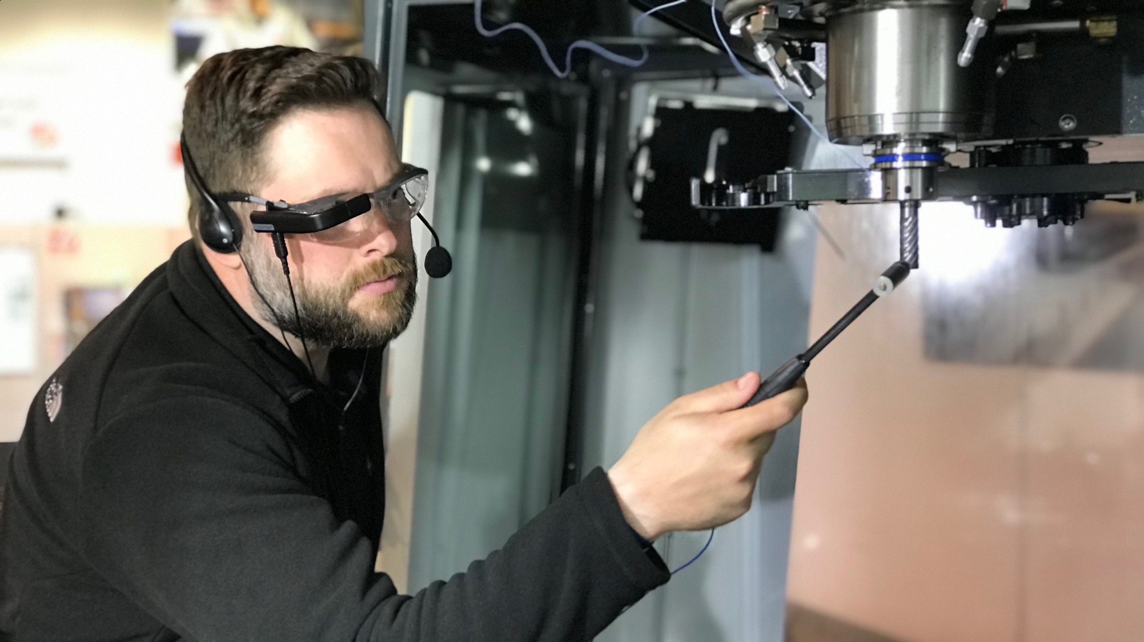
The inventors of this technology have developed exclusive new software and equipment for MSC that utilizes artificial intelligence (AI) and augmented reality (AR) to deliver immediate and actionable results at the spindle.
Notes:
The inventors of this technology, both BlueSwarf and MetalMax, have developed exclusive new software and equipment for MSC that utilizes artificial intelligence (AI) and augmented reality (AR) to deliver immediate and actionable results at the spindle.
If you have tap-testing capabilities in your company, you don’t have this and you don’t have our reach.

Slide 16

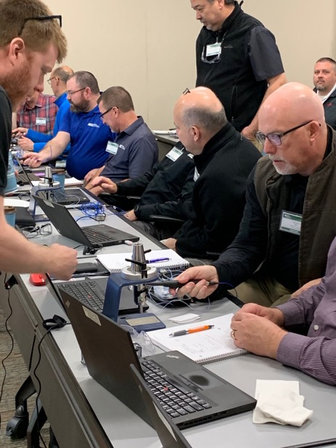
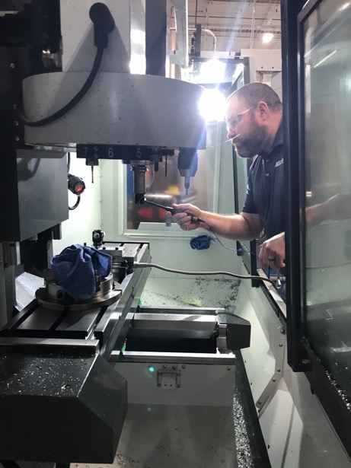
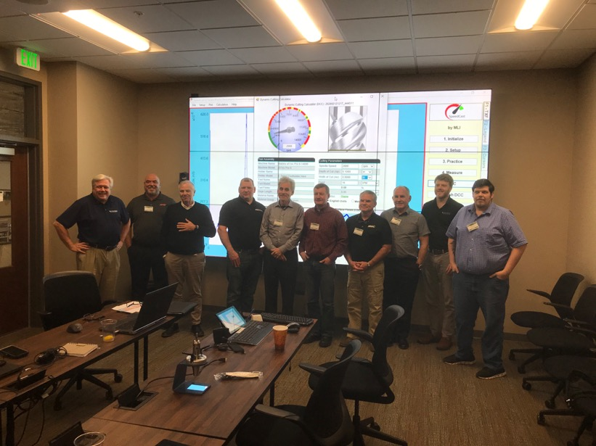
MSC established a training center on the Oak Ridge campus where each of our 100+ Metalworking Specialists are being equipped, trained and certified.
Notes:
We have already trained and graduated two classes of MSC Metalworking Specialists and will resume as soon as we can. In the meantime we have created a state-of-the-art virtual training program.

Slide 17
The first 28 tests run by the newly trained MSC Metalworking Specialists yielded an average
170.2%
improvement in metal removal rates.
Notes:
The first two classes have been in the field delivering amazing results.

Slide 18
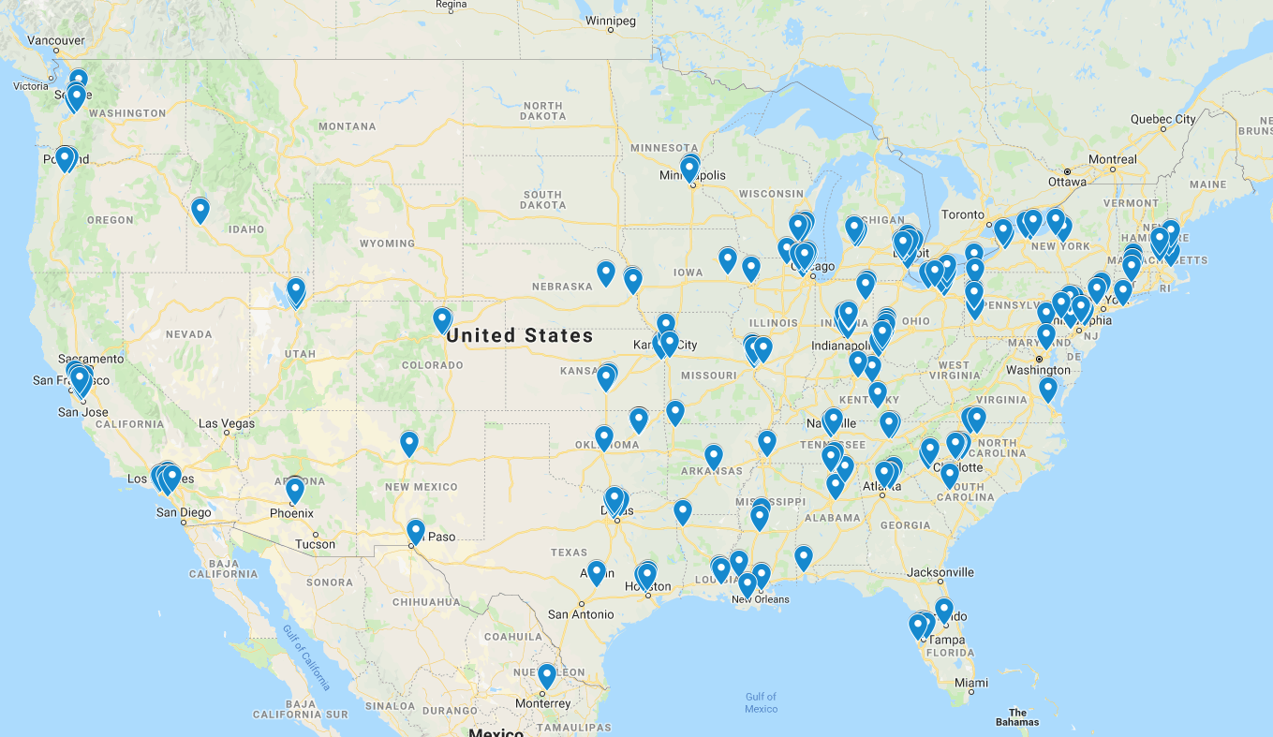
These are America’s New Machine Tool Dealer Locations
Notes:
This is a map of the new CNC machine tool distributors in the U.S. It serves as a good proxy for where metalworking customers are located.

Slide 19
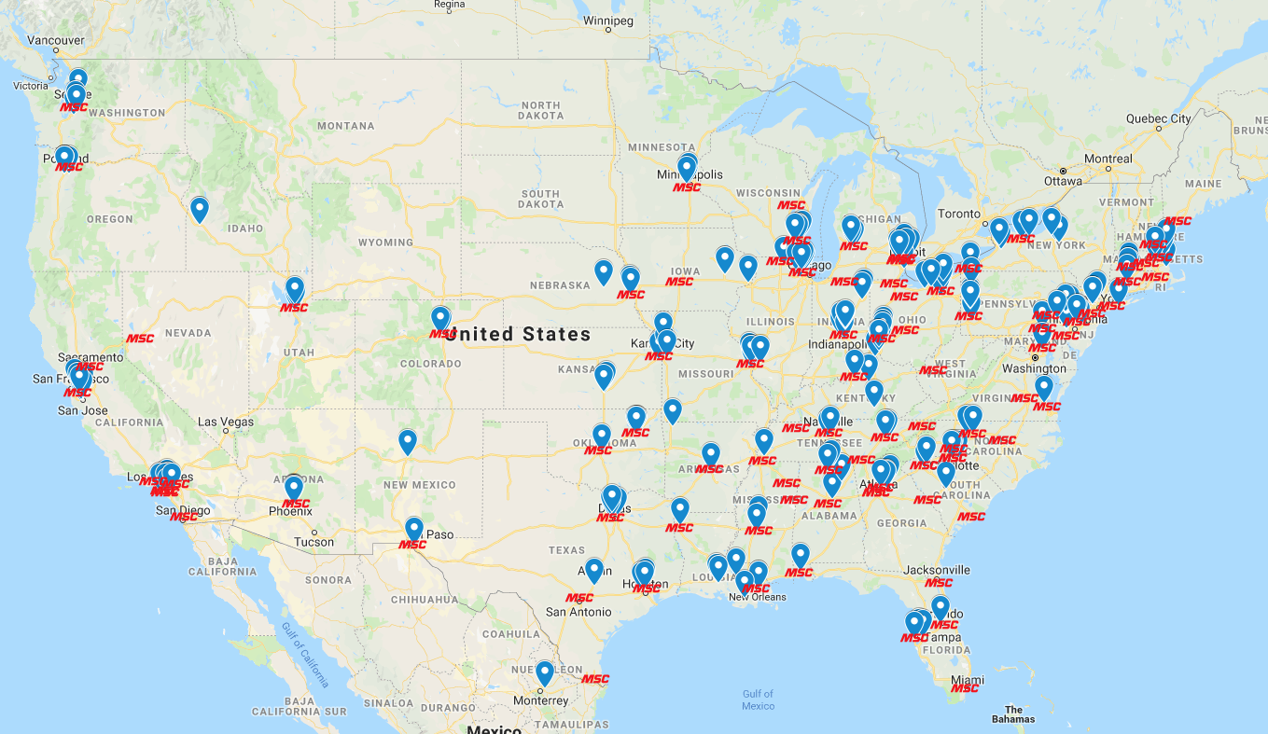
Overlay the MSC offices and the fit is almost identical
Notes:
We have MSC branch locations local to almost every machine tool dealer. Each office and their assigned Metalworking Specialist will be trained and equipped to perform Machining Dynamics tap-testing.

Slide 20

We will get to every spindle.
Notes:
We will get to every spindle on every machining center in the U.S.

Slide 21
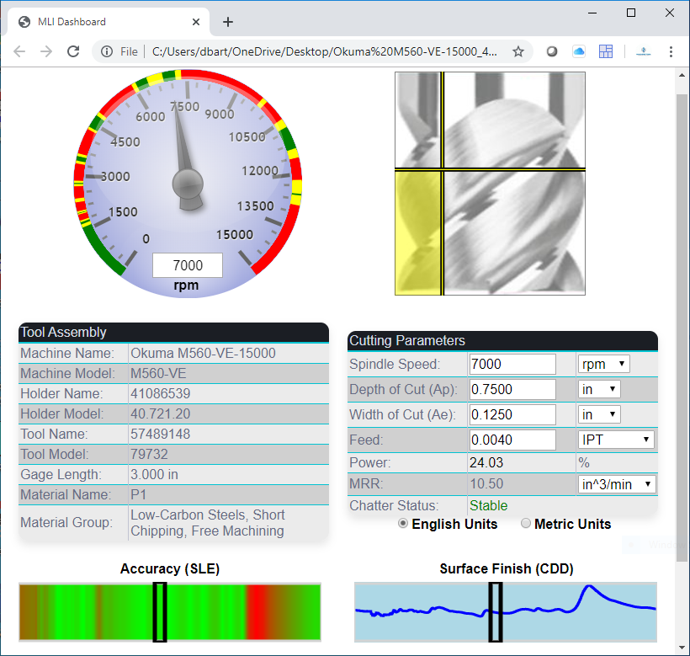
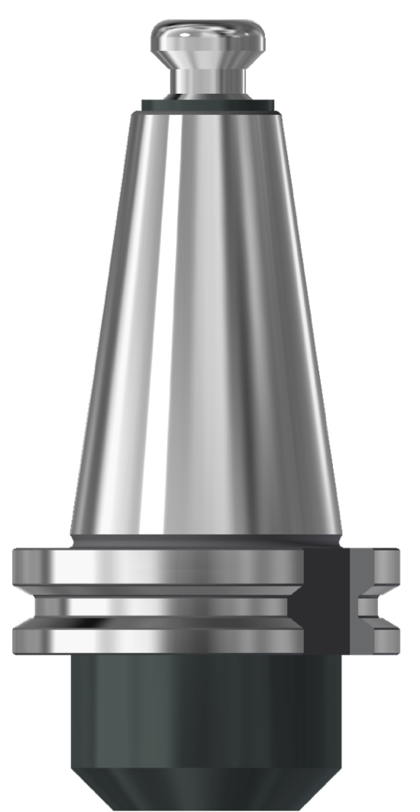
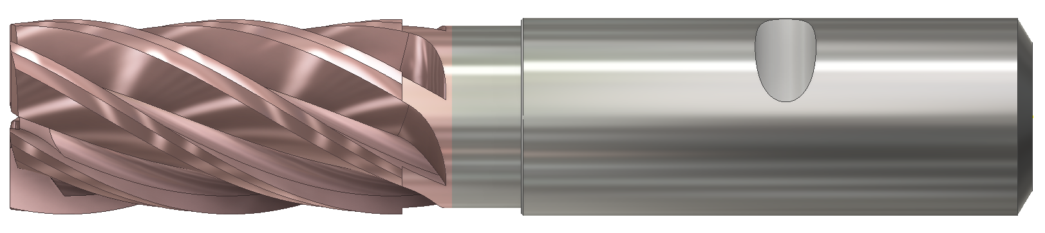
In the not-to-distant future there will be two kinds of tooling sold.
Those with paper speed and feed charts and those with optimized Dashboards
Notes:
In the not-to-distant future there will be two kinds of milling tools sold, those with one size fits all paper speed and feed charts and those sold with Dashboards optimized for their unique tool, toolholder, machine and material combination.

Slide 22
This is a mission…
Notes:
This is more than a sales plan it is a mission that we which have been chosen to help our Country.

Slide 23
By improving America’s milling productivity over the course of this project, the impact will be…
Notes:
By improving America’s milling productivity over the course of this project, the impact will be…

Slide 24
Saving enough energy to power
12.8 Million homes for a year.
Notes:
Saving enough energy to power 12.8 Million homes for a year.

Slide 25
Reducing CO² emissions
equivalent to 21 million cars.
Notes:
Reducing CO2 emissions equivalent to 21 million cars.

Slide 26
Eliminating 1.7 Billion gallons of contaminated metalworking fluids.
Notes:
Eliminating 1.7 Billion gallons of contaminated metalworking fluids.

Slide 27
Creating 750,000 new manufacturing and support jobs in the U.S.
Notes:
Creating 750,000 new manufacturing and support jobs in the U.S.

Slide 28
Are you in?
Notes:
Are you in?

